Slide 1
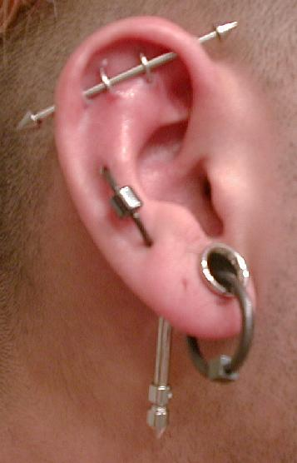
Disorders of the EAR

Slide 2
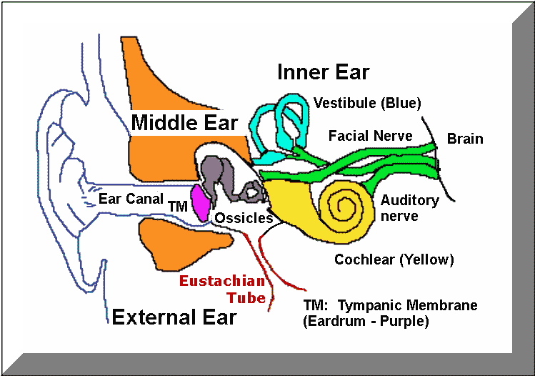

Slide 3
History Taking
Onset, Character, Duration, Precipitating Factors
--gradual or sudden?
--history of frequent colds/infections?
--recent trauma, infection, otorrhea, otalgia?
--facial paralysis, tinnitus, vertigo, imbalance?
--noise exposure (at work, home?)
--medication usage?
--family history of hearing loss?
Ear problems can be “oto-genic” or “non-otogenic”
Notes:
Does the person focus on your face when you talk?
Any history of ear surgery? Facial or dental surgery? What does the person use to clean his/her ears? History of swimming? Ear itching? Air travel? Meds: ASA, furosemide, all the “mycins” (erythro, strepto, genta-), quinine
Any behaviour problems? Loud talking? Frequently asks you to repeat or misunderstands what you’ve said?
Otogenic: problem actually started in the ear (otitis media, impacted cerumen)
Non-otogenic: pain, but referred from another source: dental caries, sore throat, TMJ, sinusitis

Slide 4
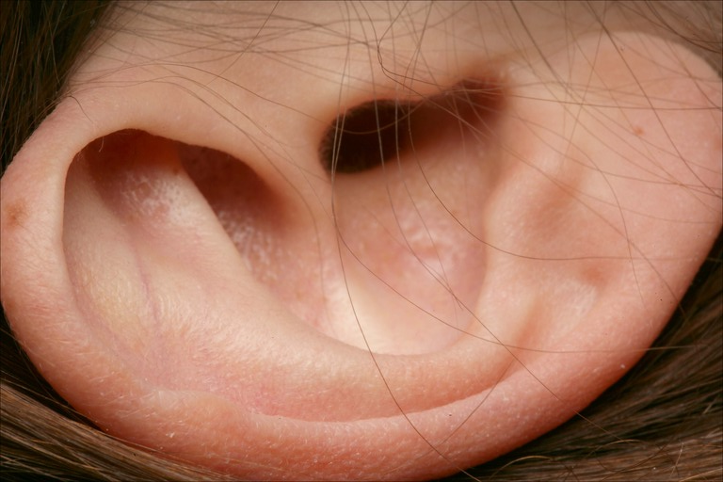
External Ear: Landmarks
Helix
Anti-helix
Tragus
Anti-tragus
Lobe
External Acoustic
Meatus

Slide 5
Clinical Examination:
EXTERNAL EAR
Shape, colour, symmetry
Crusting or weeping
Swollen or narrowed
Scar from previous mastoid operation
Swelling/tenderness over mastoid process
Other structural malformations
Palpate with fingers--cysts/tumors
Notes:
Inspect for size, configuration, angle to head; skin should be smooth without breaks or inflammation;
Structural malformations: skin tags
Look at pierced ears for irritation, infection
Any redness, drainage, swelling

Slide 6
Clinical Examination:
EAR CANAL
Use largest speculum that will fit comfortably in ear
Need good light source
Pull pinna upwards and backwards, gently
For baby, pull downwards and forwards
Colour, wax, foreign bodies, abnormalities
CHECK GOOD EAR FIRST

Slide 7

Tuning fork

Slide 8
Disorders of the External Ear
Masses
Trauma
Foreign bodies
Pruritis
Impacted Cerumen
Notes:
See Table 58-1, p. 1869 of Phipps. Most masses are infected cysts, usually from sebaceous glands. Malignant masses in ear are rare
Trauma: if limited to external ear only, treatment to prevent infection and for cosmetic reasons (hearing will remain intact); can stitch lacerations of pinna, or treat with AB cream/ointment; after any trauma, exam TM for blood, rupture, CSF leakage
FBs: irrigation is best, may use ear forceps; substance may swell if organic (and water is used)
Pruritis: itching, in elderly due to sebaceous gland atrophy: use mineral oil or glycerin

Slide 9
External Ear: Otitis Externa
Infection/inflammation of external ear canal
Causes:
  Bacterial or fungal pathogens
    Bacterial: Staphylococcus aureus
    Fungi: Aspergillis niger or Candida albicans
  Frequent swimming or bathing
  An infected hair follicle: a boil or “furuncle”
Diagnosis:
  Otalgia, Otorrhea
  Tragal tenderness
  Diffuse edema
  Itching, Sense of fullness, Hearing Loss
Notes:
Cut or scratch then exposed to perspiration, humidity, heat (moist warm environment for bacterial growth)
Any local trauma, contamination, on-going exposure to moisture
Also: too much cleaning with cotton-tipped applicators/buds
Otalgia: most common symptom
May see ↑ lymph nodes in pre and post-auricular chains
Two lab tests for ear discharge: 1) C&S for bacteria; 2) dextrostick for CSF
Fungi: “otomycosis”; may indicate underlying condition (diabetes, anaemia)

Slide 10
Otitis Externa: Treatment
Remove all infected debris
May need to I & D if necessary (boil)
Instill appropriate medication:
1. Antibiotic ear drops/solutions
2. Appropriate anti-fungal agent
3. Steroid cream: for atopic otitis externa
Educate regarding proper ear cleaning techniques:
Don’t routinely use cotton buds to clean ears
Swimming: Plug ear with cotton, dry after
Notes:
Remove by ear syringing or ear wicking; if there is a localized abscess, may need to I & D
May also use systemic antibiotics if infection is severe or extends beyond the ear canal into middle ear
Also use analgesics for pain

Slide 11
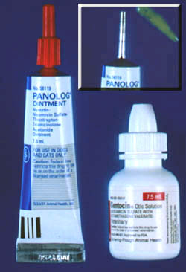
Ear Drops

Slide 12
Impacted Cerumen
WAX is NORMAL
Irrigation: (NCK pp. 58-59)
  Use lukewarm water
  Aim towards opening between plug and eardrum
  Slow, steady pressure
Curette
  Mid-to-outer canal
  Good stable head positioning
  Visualize through otoscope while using curette
Notes:
Wax: like tears for the eyes, wax is to the ear; it protects and lubricates; the ear is generally “self-cleaning”
Irrigation: Make sure eardrum is intact first (if possible); if wax is very hard and dry, can soften for a few days first with mineral oil and cotton plug, then come back for irrigation
Surgical removal: Suctioning, requires surgical microscope, referral

Slide 13
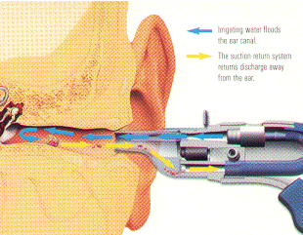
Ear Irrigation

Slide 14
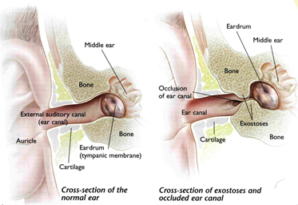
EXOSTOSES

Slide 15
Disorders of the Middle Ear
Otitis Media
  Acute
  Serous (effusion)
  Chronic
Mastoiditis
Cholesteatoma

Slide 16
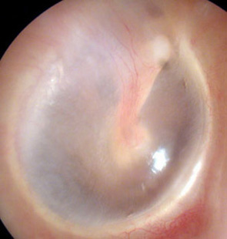
Tympanic Membrane
Color
Light Reflex
Malleus
Manubrium
Umbo
Pars tensa
Pars flaccida
Annulus
Notes:
A tense, thin membrane with 3 layers; oval in shape; vibrates with sound waves; protects the middle ear; conducts sound to inner ear
Color: pearly grey or white, translucent
Malleus: 1st ossicle; manubrium is the handle, umbo is the central bulge
Pars tensa: has three tissue layers to make it firm, tough
Pars flaccida: in the “attic”, has only two tissue layers (no central fibrous layer); more likely to see “negative pressure” here and also TM rupture
Annulus: tough, fibrous outer “ring” or border of TM with the bone
RANGE of NORMAL ANATOMY is BROAD
See Phipps pp. 1853

Slide 17
Acute Otitis Media
Inflammation of middle ear, Eustachian tube, and mastoid chamber
Cause & Pathophysiology:
  Bacteria from URI
    H. influenzae, Streptococcus, Staphylococcus
  Travels up E. tube to middle ear
  Causes infection, pus “under pressure”
  Primarily affects children
Notes:
Pediatric E. tubes are smaller, shorter, and more horizontal than in adults, so infection can travel easier (doesn’t have to fight gravity)
Children also have more lymphoid tissue around the E. tube opening, preventing pus in middle ear from draining back into nasal cavity
Children under 5, on average, get around 5-7 URIs/year; also + family history, or due to chronic smoke/dust exposure, allergies, sinusitis; children also have immature immune systems

Slide 18
Acute Otitis Media
Clinical symptoms:
  Otalgia
  Bulging, hyperemic, immobile TM
  Fever
  + purulent drainage, onset < 2 weeks
Diagnosis:
  Clinical exam and history of URI
Notes:
You MUST look in the ear to diagnose this condition! No substitute for looking!!

Slide 19
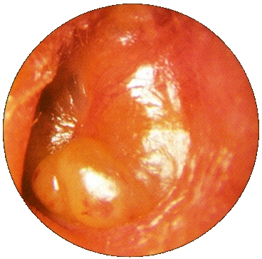
Acute Otitis Media

Slide 20
Acute Otitis Media: Treatment
IMCI Protocol:
  Give antibiotics x 5 days
    Co-trimoxazole
    Amoxycillin, Ampicillin
  Ear wicking
  Paracetamol for fever and pain
  Return in 5 days for follow-up
    Continue ABX for 5 more days if needed
Notes:
Give first dose of antibiotic in the clinic
Ear wicking if ear is draining, otherwise not needed

Slide 21
Otitis Media with Effusion
(Serous Otitis)
Fluid accumulation in middle ear
A persistence of fluid after acute otitis has resolved
May also result from air pressure trauma to middle ear:
  Airplane ride
  Scuba diving
Notes:
In a child, the treatment of otitis media with effusion is somewhat controversial. Potential treatments include watchful waiting for the fluid to resolve, a prolonged course of antibiotics or placement of a tube in the eardrum (a myringotomy tube) to allow for drainage of the fluid and to allow for air to enter the middle ear.
In the adult, otitis media with effusion is typically a temporary process that can be treated with decongestants, antibiotics, and sometimes oral steroids such as prednisone. Occasionally this fluid will not resolve and placement of a temporary tube in the eardrum to drain the fluid and allow for air to enter the middle ear is necessary.
If tubes are placed, they tend to fall out by themselves after 3-12 months—rarely have to remove by doctor

Slide 22
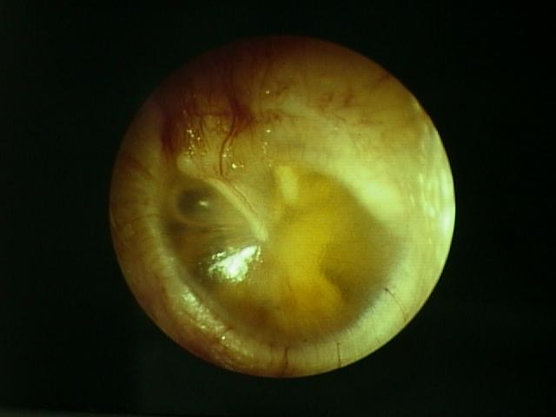
Otitis Media with Effusion

Slide 23
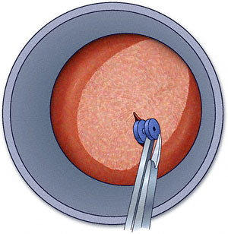
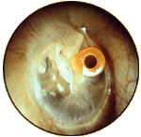
Myringotomy Tube

Slide 24
Chronic Otitis Media
A chronic, recurrent infection of the middle ear
TM is perforated
History of pus draining from ear > 2 wks
Exam:
  Draining pus
  May see inflamed, perforated TM

Slide 25
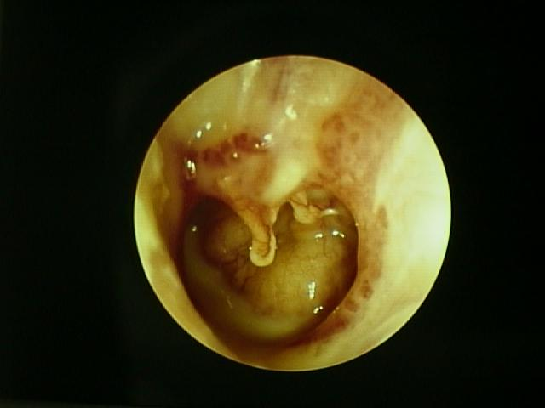
Chronic Otitis Media

Slide 26
Chronic Otitis Media: Treatment
IMCI:
  Keep ear dry by wicking
  Paracetamol for pain and fever
  Have patient return in 5 days
If ear discharge persists:
  Give single course of antibiotics
  Continue wicking
  Follow-up in 5 days
  Refer to physician if drainage persists
Notes:
Ultimately, surgery may be required to eradicate the infection and close the hole in the eardrum.

Slide 27
Mastoiditis
A bacterial infection of the mastoid cells behind the ear
Accumulation of pus
Symptoms:
  Bulging mastoid process, tenderness
  High fever
Complications:
  Meningitis
  Brain abscess

Slide 28
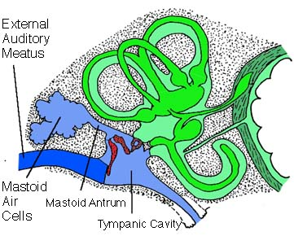
Mastoid Air Cells

Slide 29
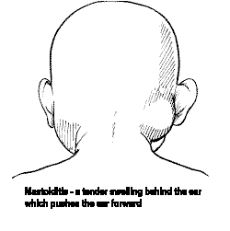
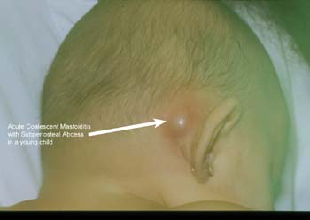
Mastoiditis

Slide 30
Mastoiditis: IMCI
Paracetamol for fever, pain
Antibiotic Therapy :
  Chloramphenicol 25 mg/kg q8h IM/IV
  Benzylpenicillin 50,000 units/kg q6h IM
Refer Urgently to Hospital:
  No improvement after 24-48 hrs
  Child deteriorates
  Signs of meningitis/brain abscess
Notes:
Give antibiotics until the child improves; then continue oral chloramphenicol every 8 hours for a total course of 10 days. The child should be checked by nurses at least every 6 hours and by a doctor at least once a day.

Slide 31
Cholesteatoma
Causes:
  Chronic E. tube dysfunction
  Chronic otitis media
Skin from TM enters middle ear through TM perforation
Skin forms expanding, sac-like growth
Puts ↑ pressure on ossicles
Causes progressive conductive hearing loss
Tx:
  Surgical excision
  Middle ear reconstruction
Notes:
Also called a “keratoma” (not really cholesterol in the cyst, but skin)
From persistent negative pressure in middle ear, where TM is constantly “sucked into” middle ear space (until it bursts); may also be congenital, although this is rare (2%)
May not see anything abnormal, or may see “whitish mass” in attic region (pars flaccida)
The danger from this lesion is the potential to erode into the brain cavity, and become fatal

Slide 32
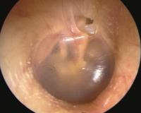
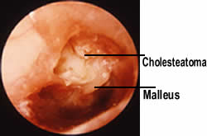
Cholesteatoma

Slide 33
Disorders of the Inner Ear
Acoustic Neuroma
Meniere’s Disease
Labyrinthitis
Tinnitus

Slide 34
Acoustic Neuroma
Slow-growing, benign tumour of Cranial VIII
Women > Men 30-60 yrs
Progressive high-frequency, unilateral hearing loss
Tinnitus, vertigo
Tx:
  Surgical excision
  May have residual hearing loss
  May affect Cranial VII
Notes:
Tumour often grows in same pathway as Cranial VII, so want to catch it early if possible: otherwise tumour can compress Cr. VII and also arteries within the ear canal
However, if ear disease includes facial palsy, must also consider dx of TB (rule out before thinking neuroma)

Slide 35
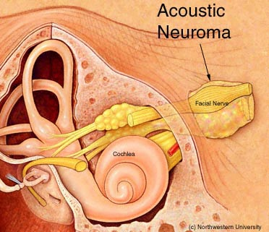
Acoustic Neuroma

Slide 36
Meniere’s Disease
Overproduction or defective absorption of endolymph
Too much endolymph → distention of membranous labyrinth
Rupture: mixing of endolymph & perilymph
SX:
  Tinnitus
  Hearing Loss
  Vertigo
Notes:
A classic “triad” of symptoms—may also have N&V, “room-spinning” dizziness, unsteady gait
Person will be “asymptomatic” between episodes at first (time required to heal rupture and restore balance, but as disease progresses, more and more ruptures occur, takes longer to recover)

Slide 37
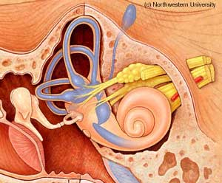
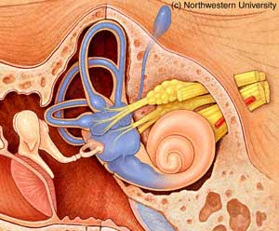
Meniere’s Disease

Slide 38
Meniere’s Disease
A hereditary, progressive disorder
No known cure
Focus is on control of symptoms:
  Anti-emetics
  Fluid restrictions, diuretics, low-salt diet
  Rest
Surgery:
  Decompression, shunts
  Labyrinthectomy
Notes:
+ family history; attacks can become progressively severe, lasting from several hours to days to weeks; recovery between attacks incomplete, with residual permanent tinnitus, hearing loss, ataxia over time

Slide 39
Labyrinthitis
Inflammation of inner ear labyrinth
Causes:
  Viral or bacterial infections
  Ototoxic drugs
Symptoms:
  Motion intolerance
  Severe vertigo, gradually lessens with time
  + or - Tinnitus
  Hearing loss
Notes:
Infections due to otitis, meningitis, even cholesteatoma left unchecked

Slide 40
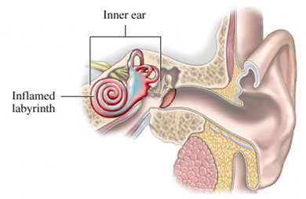
Labyrinthitis

Slide 41
Labyrinthitis: Treatment
IV antibiotics for infection
Anti-emetics
Surgery:
  Labyrinthectomy

Slide 42
Tinnitus
Pulsatile ringing in the ears
Usually bilateral
Function of aging: “presbycusis”
Other common causes:
  Meniere’s disease
  Acoustic neuroma
  Ototoxic drugs
  Exposure to loud noise over time
Use masking devices if severe
Notes:
Masking devices: clocks, radio

Slide 43
Hearing Loss and Deafness
Conductive hearing loss:
  External Ear
  Middle Ear
Sensori-neural hearing loss:
  Inner ear

Slide 44
Deafness in Young Children
Conductive:
  Otitis media
Sensori-neural:
  Genetic abnormality
  Acute hypoxia at birth or shortly after
  Rubella in mother, 1st trimester
Notes:
Your Ross & Wilson book (pp. 209-210) says most often sensori-neural in very young children

Slide 45
Deafness in Older Children/Adults: Conductive
Wax, furuncle, foreign body
Acute/Serous/Chronic Otitis
Traumatic rupture of TM
Cholesteatoma
Generally, these can be treated with good results for hearing normally

Slide 46
Deafness in Older Children/Adults: Sensori-Neural
Presbycusis
Meniere’s disease
Trauma to inner ear
  Loud noises over time
  Fracture of petrous portion of temporal bone
Labyrinthitis
Acoustic Neuroma
Prolonged use of oto-toxic drugs
Notes:
Sensori-neural usually always implies disease or trauma to the cochlea or Cr. 8; not as easy to treat these disorders; hearing aids may help but will not restore normal hearing

Slide 47
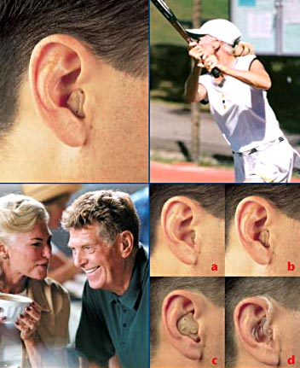

Slide 48


